Slide 1
HEAT ILLNESS

Slide 2
Requirements
Title 8, section 3395
District’s Heat Illness prevention Plan
AP4032 – Operation of Schools During Hot Weather
Landscapers, Maintenance and athletic personnel are covered by this standard
Notes:
Purpose
The purpose of this Heat Illness Prevention Plan is to prevent heat related illnesses. Cal-OSHA adopted the Heat Illness Prevention Standard on June 15, 2005 as a measure in dealing with a high number of heat related incidents & deaths in California.
This information is intended and must be used in conjunction with the San Diego Unified School District Injury/Illness Prevention Program, (IIPP).
The Heat Illness Prevention Plan establishes procedures and provides information which is necessary to ensure that employees are knowledgeable in the prevention and recognition of heat related illnesses to ensure their own safety and the safety of others.

Slide 3
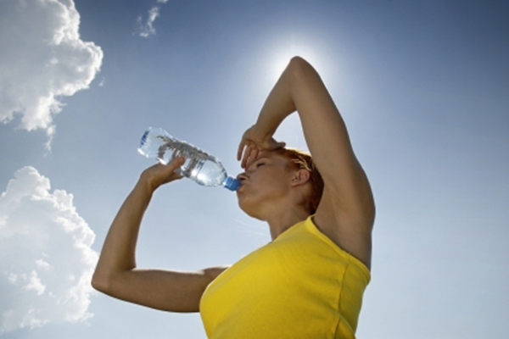
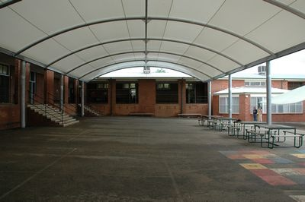
Components of Heat Illness Prevention
Access to water
Access to shade
Written procedures including emergency procedures
Training

Slide 4
Heat Can Be Fatal
In California
2012 – 4 fatalities
2013 – 5 fatalities
In US
2012 – 25 fatalities
2013 – 19 fatalities
Notes:
Each year, thousands of outdoor workers experience serious illnesses such as heat exhaustion. For 2010, the Bureau of Labor Statistics reports that 4,190 workers suffered from heat illness and 40 died from heat stroke and related causes on the job in the US.
If you’re working outdoors, you’re at risk for heat-related illnesses that can cause serious medical problems and even death but heat illness can be prevented.
Each year, thousands of outdoor workers experience heat illness, often manifested as heat exhaustion. If not quickly addressed, heat exhaustion can become heat stroke.
Heat can be a real danger for workers in jobs ranging from landscaping and construction to road repair or any other trade working outdoors or areas where temperatures are elevated.
Heat related illnesses are avoidable if supervisors and employees are trained and the right actions are taken before, during, and after working in either indoor or outdoor hot conditions. High temperature and humidity can stress the body’s ability to cool itself making heat illness a big concern, especially during hot weather periods. Every employee whose job duties require them to work outdoors in the summer months are exposed to elevated heat conditions and therefore are susceptible to heat illness.

Slide 5
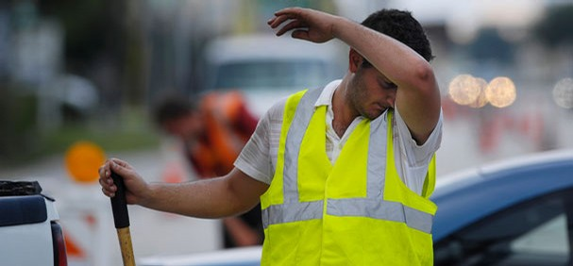
What is Heat Illness
The body’s inability to cool itself
The body normally is able to cool itself by sweating
During hot weather, especially with high humidity sweating by itself is not enough
Body temperature can rise to a dangerous level if precautions are not taken
Heat illnesses include heat rash, heat cramp, heat exhaustion and heat stroke being the most extreme
Notes:
In cases when the body is exposed to hot weather & extreme humidity, a person’s body temperature rises rapidly. Very high body temperatures may damage the brain or other vital organs. Several factors affect the body’s ability to cool itself during extremely hot weather. When the humidity is high, sweat will not evaporate as quickly, preventing the body from releasing heat quickly. Other conditions that can limit the ability to regulate temperature include old age, youth (age 0-4), obesity, fever, dehydration, heart disease, mental illness, poor circulation, sunburn, and prescription drug use and alcohol use.

Slide 6
Environmental Factors
There are several environmental factors that can effect the amount of stress a worker can experience in a hot environment.
Temperature
Humidity
Air Velocity
Radiant Heat
Notes:
Examples of radiant heat include direct heat from the sun or a furnace. Job-related factors that affect heat stress include work rate and physical effort required, type of clothing and protective equipment used, and duration of activity. All of these factors need to be evaluated in order to minimize their impact on the worker.

Slide 7
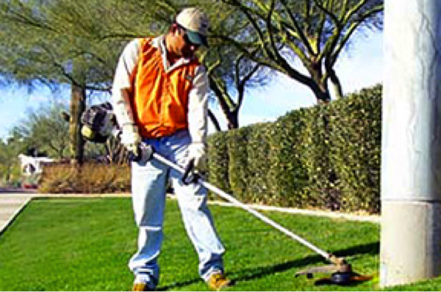
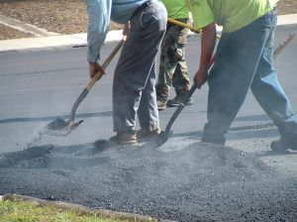
Who is at Risk?
Workers exposed to hot & humid conditions are at risk of heat illness, especially those doing heavy work tasks or using bulky protective clothing and equipment
Some workers may be at greater risk if they have not built up a tolerance to hot conditions
Notes:
Job-related factors that affect heat stress include work rate and physical effort required, type of clothing and protective equipment used, and duration of activity. All of these factors need to be evaluated in order to minimize their impact on the worker.
Personal characteristics such as age, weight, physical fitness, and acclimatization to the heat also need to be factored in to determine those people and areas at high risk.

Slide 8
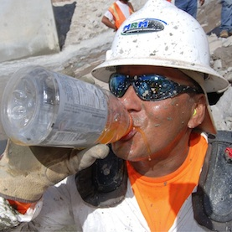
Where is the Water?
Access to sufficient amounts of cool potable drinking water shall be available at all times regardless of outdoor temperature
Notes:
Water is the body's single best defense against heat other than removing heat exposure itself. In conditions of high heat and strenuous work, the human body can lose over a quart of fluid per hour just by sweating. Continuous replacement of this lost fluid is critical to allowing the body to maintain the life-preserving cooling benefits of perspiration. This is why assuring the presence of, ready access to, and consumption of pure, fresh, and cool drinking water is so important.
Hydration: Supervisors should provide frequent reminders to employees to drink plenty of water. During hot weather periods more frequent water breaks shall be allowed and encouraged.
Drink plenty of liquids. Hydration is a continuous process, do not wait until you are thirsty, by then there is a good chance that you are already on your way to being dehydrated. Electrolyte drinks are good for replacing both water and minerals lost through sweating. Never drink alcohol and avoid caffeinated beverages like coffee and soda as these liquids can have the opposite effect and can actually increase the level of dehydration.
Potable drinking water must always be placed in locations readily accessible to all employees and the containers must be filled directly from a potable water supply.

Slide 9
Keeping Hydrated
Drink at least one quart per employee per hour for the entire shift
Avoid coffee, tea and other caffeinated beverages that can dehydrate the body
Don’t wait until you’re thirsty to drink water

Slide 10
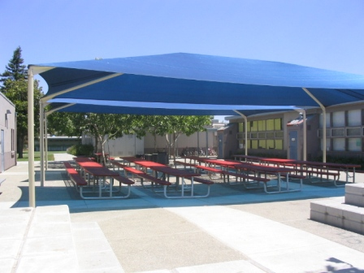
Take a Break
Take frequent breaks in the shade or air conditioned areas
Have areas of shade available at all times
Notes:
Encourage employees to take a cool-down rest in the shade, especially if you notice you are getting a headache, start feeling over heated, or begin to show any of the other symptoms of a heat related illness.
The purpose of the cool-down rest in the shade is to reduce heat stress on the employee. Shade removes sunlight as a source of heat, and since people produce more metabolic heat while working, resting reduces this as a source of heat stress, while also reducing the heart rate. Cool, fresh water should be available in the recovery area to encourage employees to drink it.

Slide 11
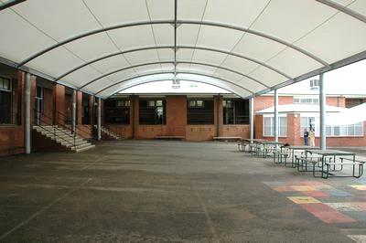
Access to shade at school sites is readily available – use it
At undeveloped location – vacant lots provide shade by using:
Umbrellas
Canopies
Other portable devices
Structures or objects that may block sun but which also contain heat, such as an automobile without the air-conditioning turned on, do not qualify as shade
Shade Areas
Notes:
At developed sites such as schools access to shade is readily available and should be taken advantage of whenever employees are suffering from a heat illness or believe that a preventative recovery period is needed. Access to shade will be available to all employees at all times for a period of no less than 5 minutes.
When employees travel to undeveloped locations such as vacant lots during hot weather supervisors must ensure that shade is provided via the use of umbrellas, canopies or other portable devices. The portable shade devices shall be set up as close to the work location as possible.

Slide 12
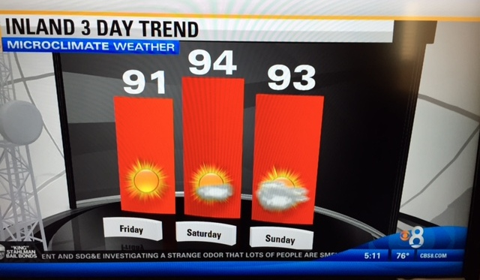
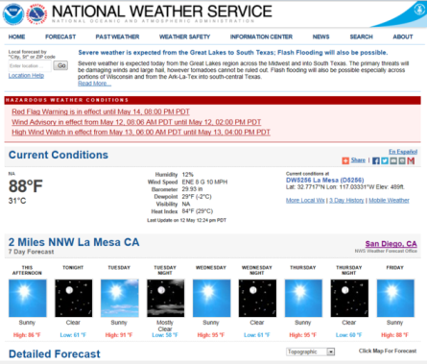
Check the Weather Report
Job pre-planning should include tracking the weather
Weather information should be used to modify work schedule, increase the number of water/rest breaks or cease work early if necessary
WWW.NWS.NOAA.GOV
Or
WWW.WEATHER.GOV
Notes:
You should monitor predicted weather temperatures in advance, for example via TV, radio or internet, so that you can have a general idea when the temperature is likely to exceed 85 degrees.
Regardless of what the predicted high has been the previous day, employers are expected to know if the actual temperature is exceeding 90 degrees F at their worksite. If the temperature enters this range, shade must actually be present regardless of the previous day's predicted temperature high.
NOAA's Watch, Warning, and Advisory Products for Extreme Heat
Each National Weather Service Weather Forecast Office can issue the following heat-related products as conditions warrant:
Excessive Heat Outlooks : are issued when the potential exists for an excessive heat event in the next 3-7 days.
Excessive Heat Watches: are issued when conditions are favorable for an excessive heat event in the next 12 to 48 hours.
Excessive Heat Warnings/Advisories: are issued when an excessive heat event is expected in the next 36 hours.
For more detailed information go to NOAA’s website http://www.noaawatch.gov/themes/heat.php

Slide 13
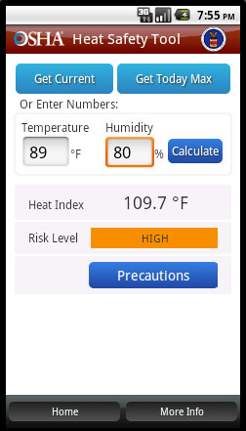
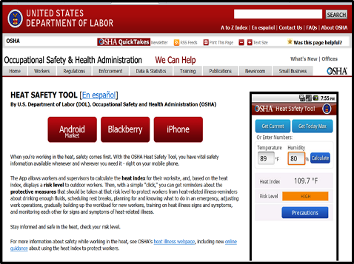
Heat Safety APP for Phones
Heat Safety App is available for several different types of phones
Notes:
OSHA Heat Stress App for Blackberry, I-phones and Android type phones. A good resource tool that may help keep employees informed. You can find out more information about the app at http://www.osha.gov/SLTC/heatillness/heat_index/heat_app.html.

Slide 14
Procedures During High Heat
For personnel that must work at one of the un-developed or unstaffed district sites the following must be in effect:
Ensure effective communication takes place by
Verbal
Observation
Electronic means
Observing employees for alertness and signs or symptoms of heat illness
Reminding employees throughout the shift to drink plenty of water
Close supervision of a new employee by a supervisor or designee for the first 14 days of the employee’s employment
Notes:
The high heat procedures are primarily for maintenance personnel that have to work at sites that are vacant.
When the temperature equals or exceeds 95 degree Fahrenheit, employers shall implement the high-heat preventive procedures as listed below:
1. Ensuring that effective communication by voice, observation, or electronic means is maintained so that employees at the work site can contact a supervisor when needed. An electronic device, such as a cell phone or text messaging device, may be used for this purpose only if reception in the area is reliable.
This preventive measure is particularly important in circumstances where the supervisor is not present at the site and needs to be immediately alerted of a problem, such as when the outdoor temperature has suddenly spiked or the water used for replenishing containers have run out.
2. Recognition of signs or symptoms of heat illness by a supervisor is crucial for assuring that sick workers be provided immediate access to shade and medical treatment. Delay of prompt medical response is likely to occur if employees working individually or in small groups suffer heat cramps, disorientation or loss of consciousness or any other symptoms of heat illness without the supervisor’s knowledge.
In instances where employees work in small groups without a supervisor present throughout the shift, the supervisor may designate an employee with sufficient experience and training to look for signs and symptoms of heat illness. It must also be reiterated that such a designated observer must know what steps to take if heat illness occurs.
3. Reminding employees throughout the shift to drink plenty of water! Some employees are more likely to skip drinking water and or taking rest breaks because they were in a rush to finish their work, and did not realize this could increase their risk of heat illness.
4. Close supervision of a new employee by a supervisor or designee for the first 14 days of the employee’s employment. Heat illness studies showed the importance of supervising new employees to ensure that necessary preventive measures such as frequent drinking of water and taking cool down breaks are followed. This period gives new employees time to acclimate to the heat.

Slide 15
Acclimatization
Newly hired employees need time to acclimate during periods of heat
Modify the work schedule or reschedule non-essential duties during hot summer months
Know how to recognize immediately signs/symptoms of heat illness
Notes:
People need time for their bodies to adjust to working in heat. This acclimatization is particularly important for employees returning to work after a prolonged absence, recent illness or recently moving from a cool to a hot climate.
For heavy work under hot conditions, a period of 4 – 10 days of progressively increasing work time starting with about 2 hours of work per day is recommended.
For less severe conditions at least the first 2 or 3 days of work in the heat should be limited to 2 to 4 hours.
Supervisors should monitor employees closely for signs and symptoms of heat illness, particularly when they have not been working in heat for the last few days, and when a heat wave occurs.

Slide 16
Warning Signs
Watch Out
If left untreated, heat exhaustion can progress into heat stroke
Seek medical attention immediately once you recognize the symptoms
Heat Exhaustion
Paleness
Tiredness
Weakness
Dizziness
Headache
Fainting
Muscle Cramps
Heavy Sweating
Nausea or vomiting
Heat Stroke
Extremely high body temp (103° F+)
Red, hot, dry skin (with no sweating)
Rapid, strong pulse
Throbbing headache
Dizziness
Nausea
Confusion
unconsciousness
Heat-related illness is
Preventable
Stay somewhere cool
Drink plenty of water
Avoid sugar, alcohol & caffeinated beverages
Wear light weight, light colored clothing
Notes:
Signs and symptoms of heat exhaustion. Signs and symptoms of heat exhaustion are similar to those of shock:
The victim will appear ashen gray; the skin cold, moist, and clammy.
The pupils of the eyes may be dilated (enlarged).
The vital signs (blood pressure, temperature, pulse, and respiration) usually are normal; however, the victim may have a weak pulse together with rapid and shallow breathing.
Body temperature may be below normal.
Signs and symptoms of heatstroke. Sometimes the victim may have preliminary symptoms such as headache, nausea, dizziness, or weakness. Breathing will be deep and rapid at first, later shallow and almost absent. Usually the victim will be flushed, very dry, and very hot. The pupils will be constricted (pinpoint) and the pulse fast and strong.

Slide 17
First-Aid for Heat Exhaustion
Move to a cooler location
Drink cool (not icy) water – take small sips
Loosen clothing and apply cool, wet towels to the body
If vomiting do not give any more fluids
Seek medical attention immediately!
Notes:
Treatment of heat exhaustion. To treat heat exhaustion victims, you should treat them as if they were in shock.
Loosen the clothing; apply cool, wet cloths.
Move the victim to either a cool or an air-conditioned area, and fan the victim.
Do not allow the person to become chilled.
If the victim vomits, don’t give any more fluids.
Transport the victim to a medical facility as soon as possible.

Slide 18
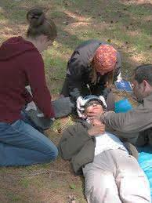
First-Aid For Heat Stroke
Have person lie down
Apply cold compresses
Move them to a cooler location
Use fan to lower temperature
Seek Medical Attention
Notes:
Treatment of heatstroke. When you provide first aid for heatstroke, remember that this is a true life-and-death emergency. The longer the victim remains overheated, the higher the chances of irreversible body damage or even death.
First-aid treatment for heatstroke is designed to reduce body heat and includes the following:
Reduce body heat immediately by dousing the body with cold water, or applying wet, cold towels to the whole body.
Move the victim to the coolest possible place and remove as much clothing as possible.
Maintain an open airway.
Place the victim on his or her back, with the head and shoulders slightly raised. If cold packs are available, place them under the arms, around the neck, at the ankles, and on the groin.
Expose the victim to a fan or air-conditioner since drafts will promote cooling.
Get the victim to a medical facility as soon as possible.

Slide 19
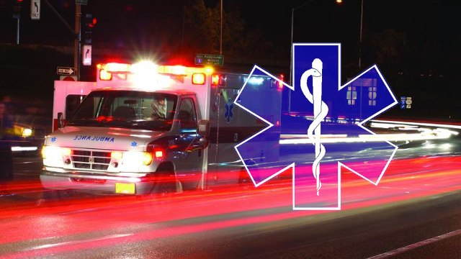
Remember the Following
Wear lightweight, light colored clothing
Use sunscreen, hat and sunglasses
As strain from heat increases, body temperature and heart rate can rise rapidly
Exposure to heat can be serious no matter what the age
Drink plenty of water throughout the day
Know what to do when a worker exhibits signs and symptoms of heat illness
Don’t Let It Come Down To This

Slide 20
Have Any Questions?
Have any questions?
Contact the safety Office at 858-627-7348 or go to the Safety Management Website
More information can be found on the following websites
OSHA https://www.osha.gov/SLTC/heatillness/index.html
CA-OSHA https://www.dir.ca.gov/dosh/heatillnessinfo.html
Center for Disease Control http://www.cdc.gov/extremeheat/

