Slide 1
If You Don’t Have Consent, You Don’t Have Consent!
A lesson plan from Advocates for Youth’s Rights, Respect, Responsibility: Elementary Edition

Slide 2
We are going to read a story together.

Slide 4
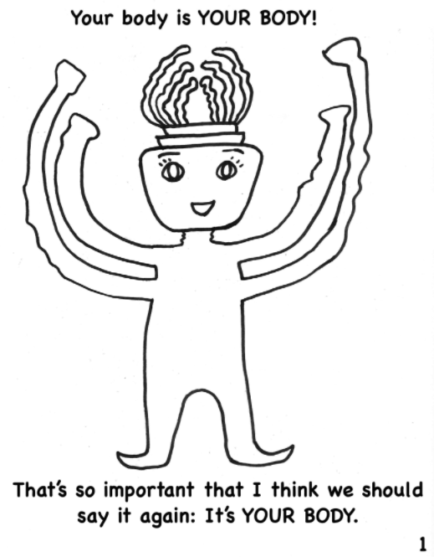

Slide 5
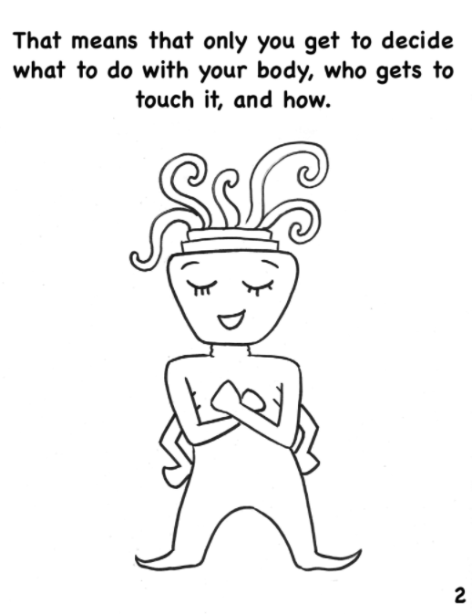

Slide 6
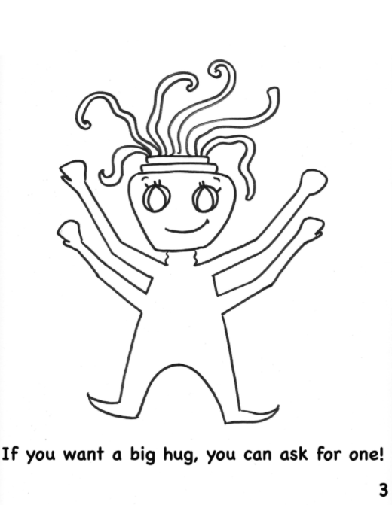

Slide 7
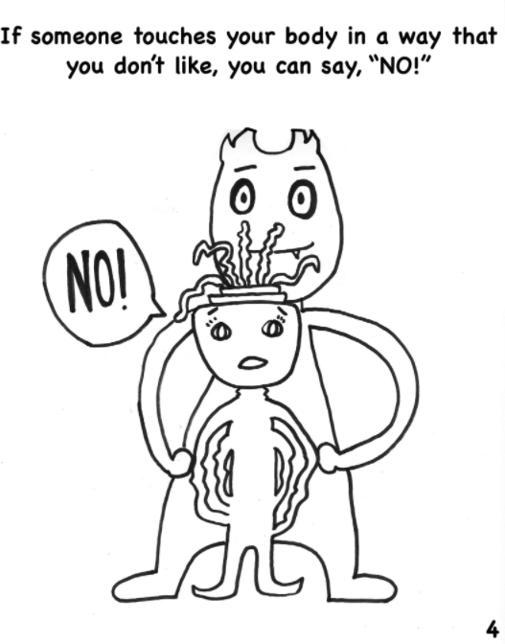

Slide 8
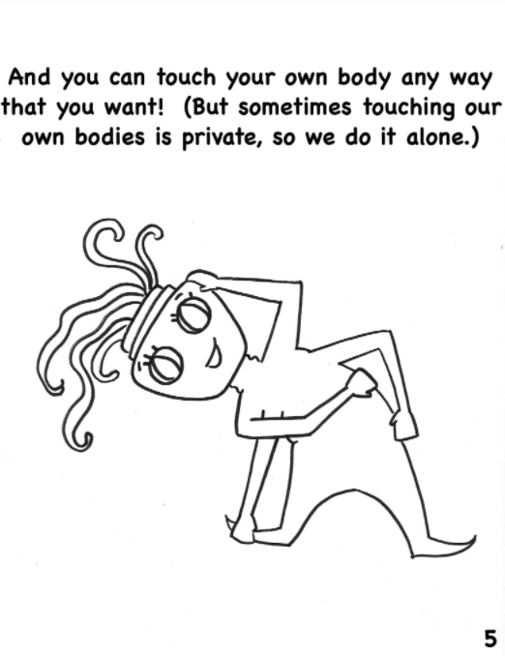

Slide 9
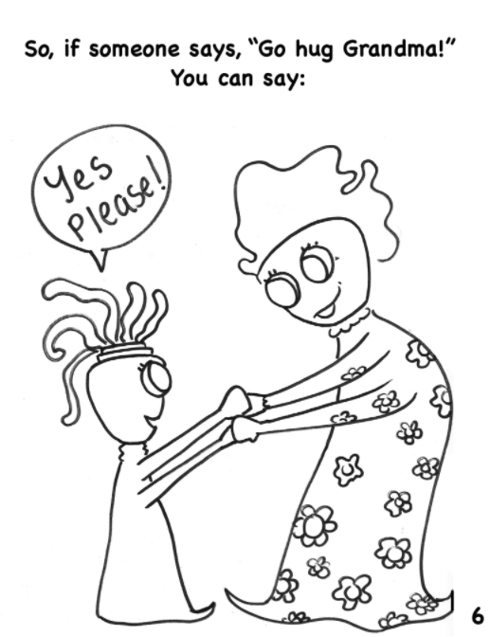

Slide 10
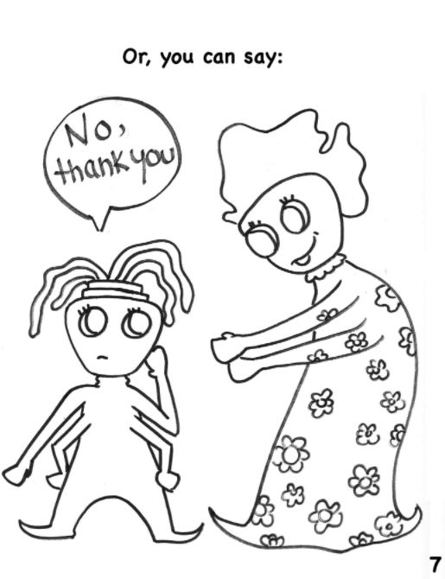

Slide 11
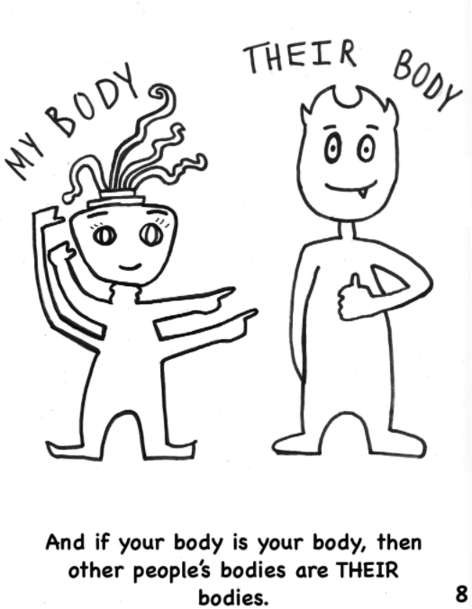

Slide 12
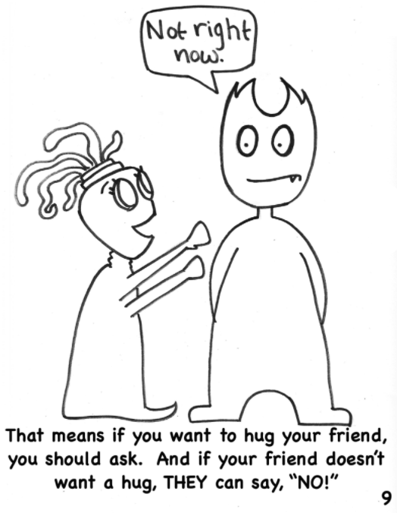

Slide 13
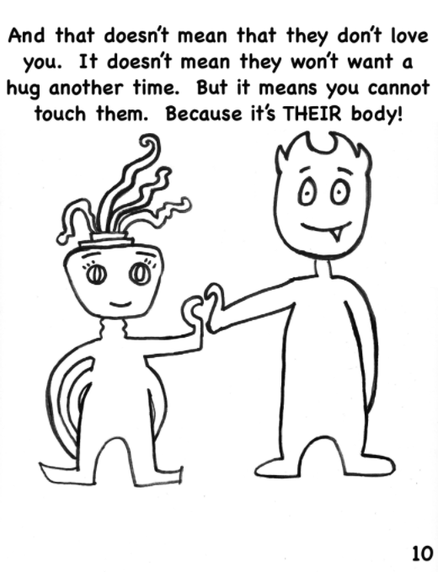

Slide 14
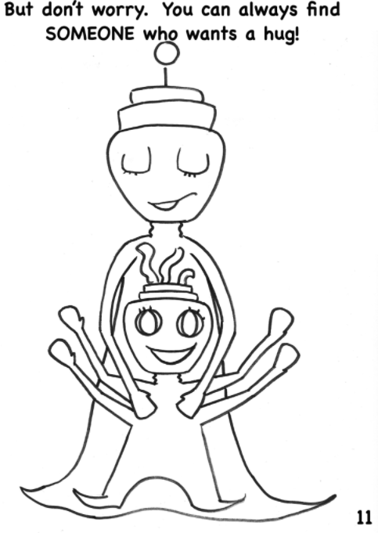

Slide 15
Summarize the Story
Would anyone like to tell us what they heard from the story?
Here are some hints if you need them…
Everyone’s body is their own body.
You get to decide who touches your body and who doesn’t.
You get to decide what type of touch you are okay or NOT okay with.
Other people also get to decide these things about their bodies, and that means we ALL have to respect other people when they say they don’t want to be touched.
No, I would not like to hug right now.

Slide 16
Vocabulary Check
What does “bodily” mean?
bodily means “your body”
What does “autonomy” mean?
autonomy means “you get to decide”
So bodily autonomy means …
You get to decide what happens to your body!
Being touched is a personal boundary.
Personal means “each person gets to decide”
Boundary means “a limit”
So a personal boundary might mean you are okay with being hugged by one person, but not another; or it could mean you don’t like hugs at all.

Slide 17
So what does consent mean?
Consent is another word for “permission.”
If you do not have someone’s consent you need to ask for it before you hug or touch them in any way.
If someone tries to touch you when you have not given them permission to, you have the right to tell them to STOP – and they have the responsibility to STOP.
If they don’t stop, it is important that you tell someone (a trusted adult, like a parent or a teacher) right away.

Slide 18
Practice!
How do you know what someone’s personal boundaries are?
You need to ask!
Get into partners so we can practice talking about consent.

Slide 19
Partner Talk
*Important note – we will not actually be hugging each other, we are just talking about hugging.
Partner A, ask your partner B these questions, and partner B should respond with their honest opinions. Then switch!
Do you like getting hugs?
Who do you like getting hugs from?
When do you NOT like getting hugs?
When you are both done sharing, lets go over these questions:
How did your partner feel about hugging?
What did they say to let you know how they felt?
What should someone do if they have set a personal boundary and the other person doesn’t respect it?

Slide 20
Sharing You can think in your head or share aloud.
Has anyone ever done something to another student that the other student hasn’t liked? What are some examples?
If you have, what did you do once you found out you did something that didn’t respect the other person’s boundaries?

Slide 21
Let’s Remember
It’s very important to be clear about our boundaries.
It’s super important to ask someone else about their boundaries.
If someone hasn’t respected your personal boundaries, even after you’ve told them what they are, you need to find a trusted adult and tell them!
You have the right to say who can and cannot touch you, and in what ways!

Slide 22
