Slide 1
Menstruation, Pregnancy & Childbirth
LESSON 14
Notes:
Suggested Script:
Oftentimes people think that pregnancy just “happens.” But modern birth control methods allow people to prevent or plan pregnancy. Today’s lesson is on pregnancy, what people can do to increase the chances of having a healthy pregnancy, and options available to someone who becomes pregnant.

Slide 2
Notes:
Show slide #2, with images of different types of families. Remind students that there are lots of types of families, and ask them to start thinking about what kind of family they might want to have someday. Then turn to the Do Now questions on slide #3, and ask students to write their responses to the questions.

Slide 3
DO NOW:
What type of family would you like to have?
Would you like to be: Single? Partnered? Married? In a committed relationship?
Would you like to have children or not? If yes, how many? At what age?
Notes:
Have students complete the do now question.

Slide 4
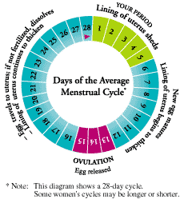
Menstruation & Conception
All About Periods…
Notes:
Suggested Script:
In order to understand how and when pregnancy is possible, we need to first understand menstruation and the menstrual cycle.
Understanding menstruation helps us understand how pregnancy can occur. Now we know that about 2 weeks before the period begins, or halfway through someone’s cycle is when ovulation tends to occur. If a cycle lasts 28 days, the time when someone will be most fertile (likely to get pregnant) is between days 11-16 of the cycle. It will be 7 days sooner in someone with a 21-day cycle, 7 days later in someone with a 35-day cycle. Periods may be irregular for 12-18 months after menarche (first period) – for example for a teen they might have 21 days between periods, then 28 days, and then 20 days. It is very common for teens to have irregular cycles; as teens get older their cycles tend to become more regular.

Slide 5
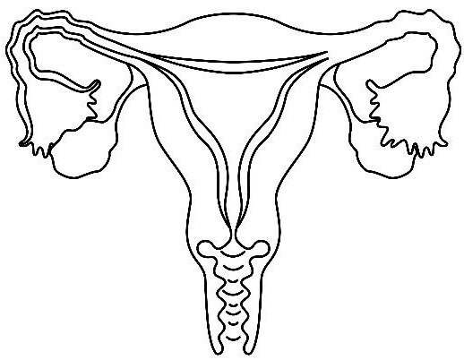
What is Menstruation?
The shedding of the uterine lining through the vagina, commonly called “a period”
Periods may be irregular for 12-18 months after menarche (first period)
Notes:
Menstruation is when the lining of the uterus sheds and comes out of the body through the vagina. Some people call this “a period.” Someone will usually get their period once a month at roughly the same time every month, but it may take 12-18 months after the first period before it becomes regular. It is common and normal for teens to have irregular periods.

Slide 6
Facts about Menstruation
Typical blood loss is 1 – 6 tablespoons
People can use pads, tampons, or menstrual cups to catch the blood
About 50% of females have cramps. There are many ways to relieve cramps, including staying hydrated, stretching, using a heating pad, doing minor exercise, and taking pain medication.
Notes:
About 1-6 tablespoons of blood comes out over the 4-7 days that a person has a period. However, this blood is thicker and darker because it contains skin cells and tissue. There may be clumps of skin cells in the blood. This is normal.
People can use different types of products to catch their menstrual blood. These include pads, tampons, and menstrual cups. It is recommended to avoid scented products because they can cause irritation. Someone could talk with a parent/guardian or trusted adult to figure out what products to use.
About half of all females get period cramps. Using a heating pad or hot water bottle on the abdomen can help to relieve discomfort. Staying hydrated, doing mild exercise, eating healthy foods, and stretching can also help with cramps. If menstrual cramps are severe someone can take over the counter pain medication or talk to a healthcare provider.

Slide 7
What is the Female Sexual Cycle?
Menstrual Cycle = how the ovaries and other sexual organs prepares itself each month to accommodate a growing pregnancy if it were to occur
The time between when “periods” start
Normal for a menstrual cycle to be between 21-35 days long
Controlled by the hormones estrogen and progesterone
Notes:
Menstruation happens on a monthly cycle, anywhere between 20-45 days- average is 28 days. This is called the female sexual cycle. The menstrual cycle is how the ovaries and other sexual organs prepares each month in case a pregnancy starts. The cycle is controlled by the hormones estrogen and progesterone.
If time allows, review the menstrual cycle using this MSNBCMedia animation:
(http://msnbcmedia.msn.com/i/msnbc/Components/Interactives/Health/WomensHealth/zFlashAssets/menstrual_cycle_dw2%5B1%5D.swf)

Slide 8
Menstruation
Last Two Weeks
Follicle Develops
= egg
(Shown much larger than actual size)
Ovulation
Notes:
The menstrual cycle begins on the first day of menstruation/period. During someone’s period, the lining of the uterus (endometrium), which consists of blood and tissue, “sheds.” A period can last 4-7 days.
After menstruation/the period is over, the body prepares to become pregnant:
The ovary will release a mature egg.
The endometrium (lining of the uterus) begins to grow again.
If the egg is not fertilized:
The egg leaves the Fallopian tube and disintegrates (breaks down).
About two weeks after the body releases an egg, the endometrium will start to shed again, beginning the cycle all over again.
The whole menstrual cycle takes about a month, but it can range from 21-35 days.

Slide 9
Menstrual Cycle
1.What hormones control menstruation?
Estrogen - Increases at beginning of cycle & controls ovulation
Progesterone - Increases around ovulation, helps to maintain pregnancy
2. When does ovulation happen?
Usually 2 weeks before bleeding begins, around the middle of the cycle.
3. When can fertilization happen?
The egg is available to be fertilized in the fallopian tube for 24 hours after ovulation. Sperm can live & fertilize an egg for up to 5 days after ejaculation.
4. What happens if an egg is not fertilized?
The egg disintegrates. (breaks down) Estrogen and progesterone levels drop. The lining of the uterus (endometrium) sheds during menstruation.
Notes:
NOTE: Slide is animated. Click on the question to make the answer appear!

Slide 10
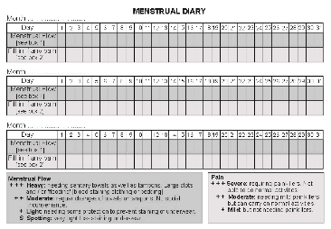
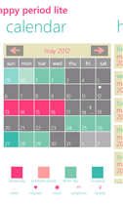
Keeping Track of Periods
CHART
FREE PHONE APPS
iPeriod (Apple)
Happy Period (Android)
www.patient.co.uk/diagram/Menstrual-Diary.htm
Period questions answered - ubykotex.com
Notes:
People can use a chart, mark a calendar, or use a phone application like iPeriod or p tracker to keep track of the menstrual cycle. These apps are useful for tracking periods and for being in touch with one’s body. They can also be used by someone who is trying to start a pregnancy. However, they are not accurate enough to track ovulation as a way to avoid pregnancy (as a birth control method).

Slide 11
FERTILIZATION
Fertilization occurs in the fallopian tube (2 weeks before period would begin)
Over half of all fertilized eggs don’t become a pregnancy
If it lives, within 12 hours the egg begins to divide & travels down the fallopian tube toward the uterus
Notes:
When fertilization occurs – usually 14 days/2 weeks before the next period would begin.
Where fertilization occurs – in the Fallopian tube.
Over half of all fertilized eggs don’t survive to become a pregnancy.
If it lives, within 12 hours, the egg begins to divide – 2 cells become 4, 4 become 8, etc. as the egg travels down the tube.

Slide 12
IMPLANTATION When Pregnancy Begins
Egg reaches uterus after 4-5 days & plants itself in the endometrium. This is called implantation.
Implantation is what most health care providers consider the beginning of pregnancy (conception)
Notes:
By day 4 or 5 it reaches the uterus and “plants” itself in the endometrium (lining of the uterus). This is called implantation.
This is what most health care providers consider conception, or the beginning of pregnancy.
To help students better understand this process, consider showing the Nova video here: http://www.pbs.org/wgbh/nova/miracle/program_adv.html

Slide 13
PREGNANCY OPTIONS
Notes:
Suggested Script:
“In California, if a female becomes pregnant there are options available. We will learn about these options in this next section. Some people may have strong beliefs and ideas about these options. We are not here to discuss what is “right” or “wrong” – We are here to discuss the options that a person can legally access in CA if they become pregnant. If you would like to discuss your values and beliefs around these options, we can identify some places and people for you to talk to.”

Slide 14
Pregnancy Options
Carry pregnancy to term & become a parent
Carry pregnancy to term & make an adoption plan
Abortion
Minors can have an abortion without parent/guardian permission
In CA, legal up to 24 weeks & after 24 weeks to save life or health of mother
Notes:
Carry pregnancy to term & become a parent: Teens who choose parenting have the right to stay in school and California provides services to support them in their pregnancy and parenting.
Carry pregnancy to term & make an adoption plan: There are a few different types of adoption and ways to plan an adoption. There are many resources and agencies to support somebody with this decision.
NOTE: When someone chooses to carry a pregnancy to term they can access prenatal care to ensure a healthier pregnancy and childbirth. There will be more information about this in the next section.
Abortion
Abortion is choosing to end a pregnancy.
Under California law, minors can access abortion services confidentially, meaning without their parent/guardian’s permission.
In California, abortion is legal up to 24 weeks into the pregnancy for any reason. After 24 weeks, abortion is still possible if the life or health of the mother is threatened by pregnancy.
There are two main types of abortion.
Medication abortion is available up to 9 weeks into the pregnancy. This involves taking a medicine. The medicine is taken outside of a health center, usually in someone’s home or in a safe place. A follow-up visit is needed to make sure that the abortion is complete.
In-clinic abortion is available up to 24 weeks into the pregnancy. It can be done in a variety of ways. This type of procedure is performed in a health center, hospital, or a doctor’s office.

Slide 15
CA Safe Surrender Baby Law
Parent can legally surrender a baby within 72 hours of birth
Baby must be dropped off at a “Safe Surrender” Site:
Hospital
Fire department
Police station
Notes:
California’s Safe Surrender Baby Law
A parent can safely surrender a baby to a designated Safe Surrender site (hospital, fire department, police station) within 72 hours of its birth. “Safe” means that the parent will not get in legal trouble for doing so. This also means that a baby, that might not have been cared for if it stayed with it’s parent, is now safe. This is intended for emergency situations.

Slide 16
Pregnancy & Childbirth
Notes:
Explain to students that you will now be reviewing information about how a pregnancy develops and how a baby is born.
Teacher Tip:
If time allows, cue up and show the 3rd chapter of PBS’s 8-part film: Life’s Greatest Miracle. This chapter shows the sperm’s journey to the egg. It is available online at: http://www.pbs.org/wgbh/nova/miracle/program_adv.html If you’d like to go into more depth on this topic, or would like to show students video of pregnancy and birth, the DVDs “The Miracle of Life” and “From Conception to Birth” have been approved for use in SFUSD high schools, and are available for check out from School Health Programs. Call 415-242-2615 for more information.

Slide 17
Pregnancy Symptoms
What are some physical signs of pregnancy?
Missing a period
Tender, swollen breasts
Fatigue / tiredness
Nausea with or without vomiting
Frequent urination
Notes:
Brainstorm early pregnancy symptoms. Ask the class what they think are some symptoms or signs that a person is pregnant. Correct any misinformation. Click to reveal the answers.
Suggested Script Not all females experience the same symptoms to the same degree. In fact, some females experience no symptoms at all early on in a pregnancy. Someone who has had unprotected penis-vagina sex and notices any of these symptoms may want to get a pregnancy test. Pregnancy tests are FREE at teen clinics and can be done as early as 2 weeks after unprotected sex to see if a pregnancy has started.

Slide 18
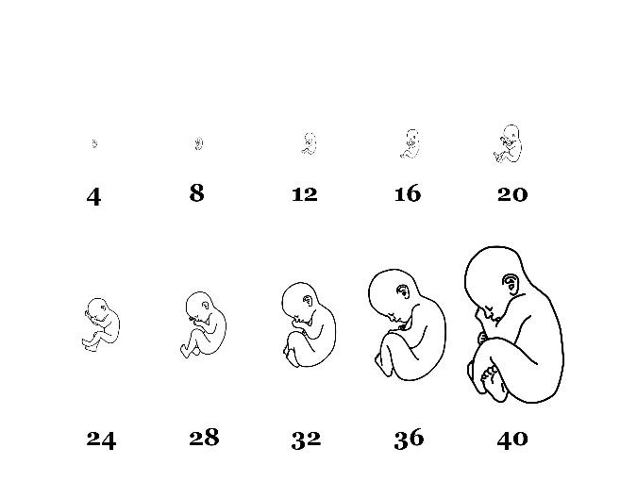
STAGES OF PREGNANCY
Weeks of development
EMBRYO – first 2 months
FETUS – from month 3 through birth
BABY – medically, only after birth

Slide 19
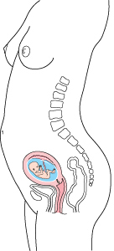
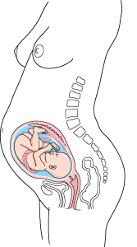
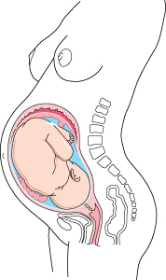
STAGES OF PREGNANCY
Pregnancy is divided into three 3-month periods called “trimesters”
1st Trimester 2nd Trimester 3rd Trimester

Slide 20
First Trimester (months 1-3)
Many people don’t know they are pregnant during 1st trimester
Embryo/fetus needs enough folic acid (Vitamin B-9) for brain development
Tobacco, alcohol, drugs, infections- including STIs, and unhealthy life choices are harmful embryo/fetus
MEDICATION ABORTION (pill) available through week 9 at most health centers
Notes:
During months 1 & 2
At this point, many females don’t know that they are pregnant yet. Yet, this is an important time for organ and brain development. An embryo can experience negative consequences from the pregnant female using tobacco, drugs or alcohol, becoming infected with an STI, or engaging in unhealthy behaviors.
Embryonic Development: The ball of cells develops into an embryo at the start of the sixth week. The embryonic stage lasts about 5 weeks. During this time all major internal organs begin developing.
This is also when the neural tube forms – the neural tube will later become the brain, spinal cord, and major nerves. If a female doesn’t have enough folic acid (an important B-vitamin) in her body before pregnancy, these organs may not develop properly. Folic acid plays an important role in the development of these organs, which is why some pregnant people take extra folic acid before and/or during pregnancy. We will talk about this a little later.
By the end of the 2nd month, the heart has formed, webbed fingers and toes develop, and the embryo has the beginnings of a liver, external ears, eyes, eyelids, and upper lip.
During month 3
The embryo becomes a fetus.
Umbilical cord connects the abdomen of the fetus to the placenta. The placenta is attached to the wall of the uterus:
The placenta absorbs nutrients from the female’s bloodstream.
The cord carries nutrients and oxygen to and takes wastes away from the fetus.
Fetus is about 2–3 inches long.
Hormones begin to make external sex organs appear — female or male.
Fetus begins moving.
NOTE: A medication abortion (taking a set of pills to end a pregnancy) is available at most health centers for up through 9 weeks (just over 2 months, during the first trimester).

Slide 21
First Trimester (months 1-3)
Embryo from 5-11 weeks
Major organs
Neural tube
Beginnings of eyes, ears, lips
Fetus at 12 weeks
Umbilical cord connects fetus to placenta
By end of 3rd month
2-3 inches long
Beginnings of sex organs
Begins to move
Weeks of development

Slide 22
Second Trimester (months 4-6)
Weeks of development
Organs continue to mature
By end of 2nd Trimester:
14 inches long
Cannot survive outside the uterus without a lot of special medical attention
Abortion is legal in CA up until 24 weeks for any reason & after 24 weeks to save life or health of the mother
Notes:
SECOND TRIMESTER (months 4-6):
Organs continue to mature.
By the end of the sixth month, fetus is ¾ of its birth length -- about 14 inches long.
By end of 2nd trimester, fetus cannot survive outside the uterus without extraordinary medical attention, including periodic help with breathing.
NOTE: Abortion can be legally accessed in CA up until 24 weeks (about 6 months, at the end of the second trimester). After 24 weeks, abortion is legal only if performed in order to save the life or health of the mother. This will be discussed more during the section on pregnancy options.
About 1 in 3 females will have an abortion at some point in their lives.

Slide 23
Third Trimester (months 7-9)
Brain & lungs mature
Eyes open and close
Sucks on thumb
Responds to light
Due date: 40 weeks from the first day of the last menstrual period
Average birth weight: 7.6 pounds
Average birth length: 20 inches
Weeks of development
Notes:
THIRD TRIMESTER (months 7-9):
Brain and lungs continue to mature.
Fetus begins to open and close its eyes, suck on its thumb and respond to light.
Due date: 40 weeks from the first day of the last menstrual period.
When born, the baby’s weight will average 7.6 pounds. Under 5.5 pounds is described as “low birth weight” and being over 8.8 pounds as a “high birth weight.” Being born very small or very large can mean more complications and health risks.
Average birth length is about 20 inches long from top of the head to bottom of the heel.

Slide 24
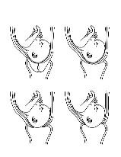
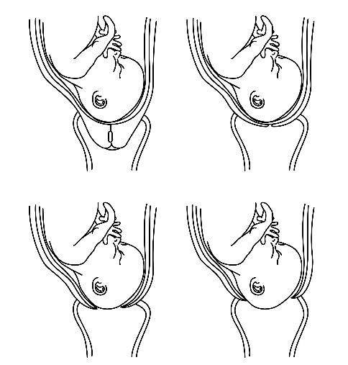
Stages of Childbirth
Early Labor: Contractions begin & cervix dilates to 3cm.
Stage 1 Active Labor: Contractions become stronger, longer, and closer together. Cervix becomes fully dilated to 10cm.
Stage 2 Delivering the baby
Stage 3 Delivering the placenta
Notes:
Explain to students that this is the process of birthing a baby. This includes labor and delivery.
There are 4 stages of vaginal birth:
Early Labor – This is when the cervix begins dilating. Contractions, or waves of sensation similar to menstrual cramps, will begin occurring at first spread apart and then closer together and more regularly. The contractions are helping to open the cervix. This stage ends when the cervix is 3 cm in dilation (about the size of a golf or ping-pong ball). This stage can last anywhere from 6-12 hours.
Stage 1: Active Labor – This is when the cervix dilates from 3cm to 10 cm (about the size of a grapefruit). Contractions will become stronger and closer together until they are happening almost one after another. The head is usually positioned on the cervix, the face positioned towards the spine. If the head is not positioned on the cervix, this is called a “breech” position. It can be safe to deliver the baby in this position, but some health care providers will recommend a Cesarean birth instead. This stage can last up to 8 hours or longer.
Stage 2: Delivery – This is when the baby is delivered. The baby has to do a series of maneuvers to twist and move through the pelvis. When the baby is born it will take its first breath of air using its lungs. Usually, shortly after birth the umbilical cord is cut. This stage can take a few minutes or a few hours.
Stage 3: Delivering the Placenta – This is when the placenta is delivered. The placenta is an organ that connects the developing fetus to the uterine wall to allow nutrients, waste, and oxygen to be exchanged between the mother and fetus. After the baby is born the uterus will continue to contract and expel the placenta. This is usually completed within 10-12 minutes after the baby has been delivered.
For people who have a Cesarean birth, sometimes it is a planned procedure and the female does not experience these stages of childbirth. Other times it is not planned and someone may go through stage 1 and 2 before deciding to have a Cesarean birth.

Slide 25
Childbirth Options
Type of birth: vaginal or cesarean birth
Setting: hospital, birthing center, home birth, water birth
Support: physician/doctor, midwife, doulas, friends, family, partner(s)
Comfort measures: medicines, positions, massage, acupressure, etc.
Notes:
There are many birthing options for someone to consider when giving birth.
Type of birth: vaginal (baby is birthed through vaginal canal) or Cesarean birth (the baby is born through a surgical procedure in which a surgeon opens the uterus). The rates of Cesarean births are increasing in the US. In 2011, 32% of births were Cesarean births.
Setting: hospital, birthing center, home birth, water birth.
Support: physician/doctor, midwife, doulas, friends/family/partner(s).
Comfort measures: medications, massage, water birth, aromatherapy, acupressure, positions (such as standing, laying down, kneeling, leaning or swatting), etc.
Explain to students that every person experiences childbirth differently. What students may have seen in movies or on TV does not accurately represent how all people experience childbirth.

Slide 26
IMPACTS ON HEALTH
Notes:
Review with students how life choices can impact our health.

Slide 27
WHAT IMPACTS HEALTH?
What actions do people do to be healthy?
What are some of things that can have a negative impact on health?
Which of these things can interfere with a healthy pregnancy?
Notes:
IMPACTS ON HEALTH
Begin the discussion by brainstorming the following:
What actions do people take to be healthy? Write down answers – might include eat healthy foods, exercise, etc.
What are some of the things that can have a negative impact on health? Write down answers – might include taking drugs, eating junk food, etc.
Which of these can help or interfere with a healthy pregnancy? Circle responses– explain that this is one of the reasons that it’s important for people who want to continue a pregnancy to get a special kind of health care called prenatal care.

Slide 28
Prenatal Care (Health care during pregnancy)
Special check-ups to maintain health of biological mother & fetus
Role of health care provider
Medical services
Help to maintain healthy life choices while pregnant
Treat potential health problems early
Provide info & answer questions
In California, available free or low-cost, including for people who are undocumented.
Notes:
Prenatal Care:
Prenatal care helps to protect the biological mom’s health. Because of more people accessing prenatal healthcare, pregnancy and childbirth are safer than ever before. (100 years ago, almost 1 in 100 births resulted in the mother’s death. Today, less than 1 in 8000 births result in the biological mother’s death. Still, this rate is much higher than the death rate from all forms of birth control combined.)
Prenatal care also helps to protect the fetus’ health. (About 150 years ago (1850), the infant death rate was 216.8 per 1,000 population for white babies and 340 per 1,000 population for black babies. In 2000, it was 5.7 per 1,000 population for white babies and 14.1 per 1,000 populations for black babies.)
Health professionals recommend that someone who is pregnant gets prenatal care as early as possible, since the first trimester of pregnancy is so important to the fetus’ development.
Prenatal care involves regular check-ups with a health care provider, usually someone who specializes in women’s health and/or pregnancy (i.e. gynecologist, obstetrician, or midwife). Usually, check-ups become more frequent later in pregnancy. The health care provider partners with the biological mother to help her and the fetus by:
Providing medical services.
Making recommendations about how to maintain a healthy lifestyle while pregnant – taking vitamins, having a healthy diet, and exercising.
Checking for and treating potential health problems early.
Providing information and answering questions about pregnancy and birth.
Under current health care law, all insurance plans must provide free or low-cost prenatal care; in California, any person, regardless of immigration and/or documentation status or age, who is pregnant, has the right to free or low-cost prenatal care.

Slide 29
Preconception Health (Health before pregnancy for all people)
Healthy Life Choices
Multivitamin with folic acid
Nutritious meals & exercise
Avoid drugs, alcohol & smoking
Manage stress
Healthy relationships
Avoid toxins / dangerous chemicals
Notes:
Going back to our previous discussion about steps people take to improve their health, why do you think it is important for all people, regardless of sex or gender, to be healthy before pregnancy occurs?
The biological father’s health can affect the health of his sperm.
The biological mother’s health can affect not only effect the health of her eggs but also the health of a growing embryo even before she knows that she is pregnant.
Being healthy before pregnancy is called preconception health (pre=before, conception=pregnancy).

Slide 30
Preconception Health (Health before pregnancy for all people)
Before pregnancy, see health care provider
Test for STIs (Family PACT covers these costs)
Vaccinations up-to-date
Get medical conditions (diabetes, high blood pressure) under control
Check to see if medications could harm pregnancy
Consider getting tested for genetic conditions
Notes:
Pass out the Preconception Health Handout.
Point out that most of the recommended actions are the same for all people. Review the basics:
Maintain a healthy lifestyle:
Take a multi-vitamin with 400-800 micrograms of a B-vitamin called folic acid every day. Folic acid helps prevent serious birth defects of the brain and spine (neural tube defects), as well as other birth defects like cleft palate. New research shows that it may also help males have healthier sperm.
Eat balanced and nutritious meals, and exercise.
Avoid drugs, alcohol, and smoking. These can affect someone’s overall health, including sperm quality and the health of a pregnancy.
Limiting caffeine before and during pregnancy can also support someone’s ability to become pregnant and maintain a healthy pregnancy.
If possible, see a health care provider before starting a pregnancy. All of the following can affect the health of a fetus and/or biological mother. Some can also affect sperm health or cause early (pre-term) birth:
Test for sexually transmitted infections (STIs like Chlamydia, Gonorrhea and HIV). Anyone 12 or older can access these services confidentially. It’s healthier to treat or cure STIs before pregnancy. STIs can be passed between sexual partners. If left untreated, STIs can be harmful to someone’s health as well as the health of a growing pregnancy. Students will learn more about STIs in a later lesson.
Make sure vaccinations are up-to-date. Certain diseases, like flu, chickenpox and measles can affect the health of a fetus.
Make sure that medical conditions are under control, including asthma, diabetes, depression, high blood pressure, thyroid disease, and epilepsy.
Check to see if any medicines, over-the-counter drugs, or herbal and dietary supplements could be harmful to a growing pregnancy.
People can choose to get tested for genetic conditions that could be inherited

Slide 31
What are the benefits of preconception health for someone who is not actively planning a pregnancy?
Better health right now
Forming healthy habits
Prepared for pregnancy (50% of pregnancies unplanned)
Notes:
Ask students to brainstorm answers to this question. Click to reveal the answers.
What are the benefits of practicing these habits, even if one isn’t planning a pregnancy?
Many of these actions help ALL individuals stay healthy.
These are things people can do to form healthy habits
50% of all pregnancies are unplanned and one of the most important times for sperm and embryo health is BEFORE fertilization. This is the reason that preconception health is recommended for anyone who is having sex that could result in a pregnancy.

Slide 32
Why would it be healthy to avoid toxic substances and dangerous chemicals in the home or work environment?
A growing fetus is even more likely to be hurt by toxins than a teenager or fully grown adult.
Notes:
Ask students to brainstorm answers to this question. Click to reveal the answers.

Slide 33
Why would it be healthy to create and establish healthy, supportive relationships?
Stress can have a negative effect on sperm production, a female’s ability to become pregnant, and a growing fetus. On the other hand, a positive relationship can support the health of a pregnant female and a fetus.
Notes:
Ask students to brainstorm answers to this question. Click to reveal the answers.

Slide 34
We serve you what's hot in pop culture with a healthy dose of honesty!
www.todayis4tomorrow.tumblr.com
Text “TODAY” to 61827 for resources, a clinic locator, & weekly tips on:
Healthy living
Safer sex
Job seeking
Mental health
More…
Notes:
Today is for Tomorrow
Direct students to the “Today is for Tomorrow” Tumblr and text campaign for teens. It gives messages of health living, including pregnancy prevention, job seeking tips, mental health, and more. If there is time, click on the link to the tumblr account.
www.todayis4tomorrow.tumblr.com/
Text “TODAY” to 61827
Explain that when the peer educators from the Teenage Pregnancy and Parenting Program come to share their experiences, they will talk more about preconception health

