Slide 1
Rights, Respect, Responsibility (Grade 6)
Being Smart, Staying Safe Online
Lesson 10

Slide 2
Reminders
Let’s review our ground rules and procedures as a class.
Remember to use the Anonymous Question Box!
Notes:
Refer to the chart poster you made for Ground Rules in Lesson 1. Remind students about the anonymous question box and any other procedures for your classroom.

Slide 3
Introduction
Have you ever heard the saying, “Don’t Talk to Strangers?”
How might this ‘rule’ change when we communicate online?

Slide 4
Introduction
The Internet gives people a wide range of opportunities to connect with or learn from people who may not be in your circle of close friends—whether through games, social networking, blogs, instant messaging, forums, etc.
While this can be great, connecting with people online occasionally can carry risks.
Therefore, it’s important to know how to deal with inappropriate situations if they arise.

Slide 5
Class Activity: “Take Three”
You are going to watch a video of three teens sharing their experiences about connecting with people online.
Pay attention to the positives and negatives that each teen mentions.
Now that the video is over, complete the “Take Three” handout with a partner.

Slide 6
Class Discussion: “Take Three”
What positives and negatives did Randy, Aseal, and Renee talk about in the video?
What advice did they share in the video that you think is important?
Would you add any advice of your own?
Renee said sometimes she has a “gut feeling” that something is wrong online. Have you ever had that “gut feeling,” whether online or in real life? What does that feel like?

Slide 7
Class Discussion: “Take Three”
That gut feeling is there for a reason—it’s kind of like an internal warning system. If something doesn’t feel quite right, chances are it isn’t. So it’s important to pay attention to that feeling and at least get out of the situation that is making you feel that way. That way you have a chance to think about what was making you feel that way and why.

Slide 8
Internet Safety
Remember that Randy and Aseal used the word “harass” in the video to describe awkward or annoying interactions with strangers online. Aseal says he was harassed during a game when someone he didn’t know said mean things about him.
Online flirting can sometimes be a less obvious form of harassment (when the flirting is unwanted).
Remember – Many online networking sites have age restrictions!

Slide 9
How Would You…
How would you handle someone walking up to you on the street and making crude or sexual comments?
How would you handle someone trying to flirt with you on the street?
The same kinds of situations can happen online. Sometimes it’s obvious that what a person is saying online is wrong or even harmful. Other times people may flirt online and warning signs are not always so obvious.

Slide 10
Flirting Can Be Risky
Flirting can be normal among middle school students. When flirting is done face to face, it might feel comfortable.
However, it quickly can become uncomfortable online, even when it’s with people that you may know. This is because people sometimes say things online that they might not say in person.
When talking online with people you don’t know in person, flirting and other sexual talk is risky behavior.

Slide 11
Flirting Can Be Risky
There are times when flirting can lead to an ongoing relationship with a stranger that seems deep and personal. But this is tricky because some people online don’t actually have your best interest in mind.
If the person you’re flirting with online says anything inappropriate or sexual, and especially if that person is older than you, stop talking right away and tell a trusted adult about it.

Slide 12
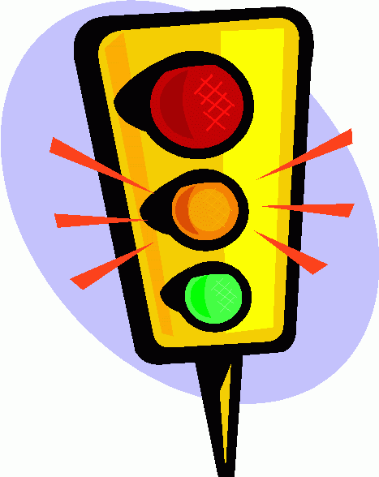
Class Activity: “Internet Traffic Light”
Take a look at the “Internet Traffic Light” worksheet.
Let’s review the “Internet Safety Tips” listed at the top of the worksheet.
Keep these rules in mind as you start this next activity.

Slide 13
Class Activity: “Internet Traffic Light”
Each student will need a green card, yellow card, and red card.
In small groups, read the directions on your worksheet and decide whether each activity is a green, yellow, or red light situation.
When you have made your choice, take one of your “lights” and place it face down in front of you.
When everyone is done with that question, flip your cards over and discuss the choices you made. Decide as a group which one is best.
Write down the choice your group made for each question and why.

Slide 14
Class Discussion: “Internet Traffic Light”
What are some positive things and what are some of the negative things about connecting with people online?
In what online situations should you get a “gut feeling” that tells you that you may be at risk?
What are some rules for staying safe when talking and messaging online?

Slide 15
Homework
Take the most important points about being safe online from today’s class. What do you think other students need to know?
Create a poster teaching other kids about Internet safety.

