Slide 1
Advocating for Change at School
(based on a presentation by Diana Thu-Thao Rhodes, Director of Public Policy, Advocates for Youth

Slide 2
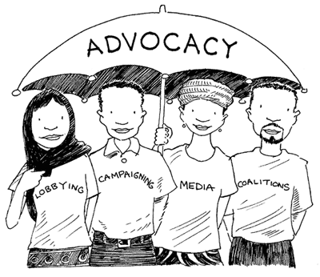
What is advocacy?
Supporting and believing in an issue and trying to get others to support and believe in the same issue

Slide 3
What is lobbying?
A form of advocacy
Conducting activities aimed at influencing decision-makers

Slide 4
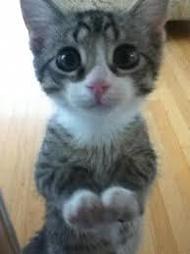
Which animal will be the School Mascot?

Slide 5
Why do we lobby?
To show the personal faces affected by the school’s policies or lack thereof.
To help show how much students care about their school.
To influence:
Policy decisions
School climate

Slide 6
You already lobby all the time!
Asking your parent(s)/caregiver(s) for permission to do something
We list the arguments for our position, point out the problems with the other side's arguments, and then enlist the help of those who have different types of power.
We use what we know in the situation to try to get our way.
Lobbying the Principal isn’t much different!

Slide 7
The Issue & The Ask

Slide 8
Lobbying the Principal
1. Introduce yourself and who you represent
2. Thank the Principal for the meeting
3. State your position clearly, specifically what is wrong and why you think that
4. Make a specific ask (“We would like…”)
5. Provide Informational materials and ask if you can count on their support
Thank the Principal again and then go back and meet with your group to decide how you might need to follow up

Slide 9
What should you do if the Principal…
Agrees with you?
Thank them for their support
Ask for a timeline for the change to happen
Ask them to take a larger role by publicizing this change to the entire school

Slide 10
What should you do if the Principal…
Disagrees with your position?
Determine the reasoning for their opposition (concern about parents’ reactions, the proposed change would cost money that wasn’t budgeted, personal/political values, the school board, etc.)
Remain calm, do not become angry
Thank the Principal for meeting with you

Slide 11
What should you do if the Principal…
Is indecisive?
Present your case clearly
Ask about the Principal’s own viewpoint
Ask about specific questions the Principal has and/or who they’d like to hear from to get more information about the issue
Keep in touch

Slide 12
Homework
Info on the impact of GSAs on all students
Info on school safety issues for LGBTQ students
Examples of schools that have made positive changes in their schools and the impact of doing that
Stories of opposition to making this type of change that was then overcome, and how
List of 3 to 5 organizations that support schools in making these changes
Fact sheets about this issue

Slide 13
Websites That Can Help (the rest you’ll have to Google ☺ )
http://www.glsen.org
http://www.safeschoolscoalition.org
http://www.tolerance.org/lgbt-best-practices
http://www.apa.org/pi/lgbt/programs/safe-supportive/default.aspx

